Slide 1
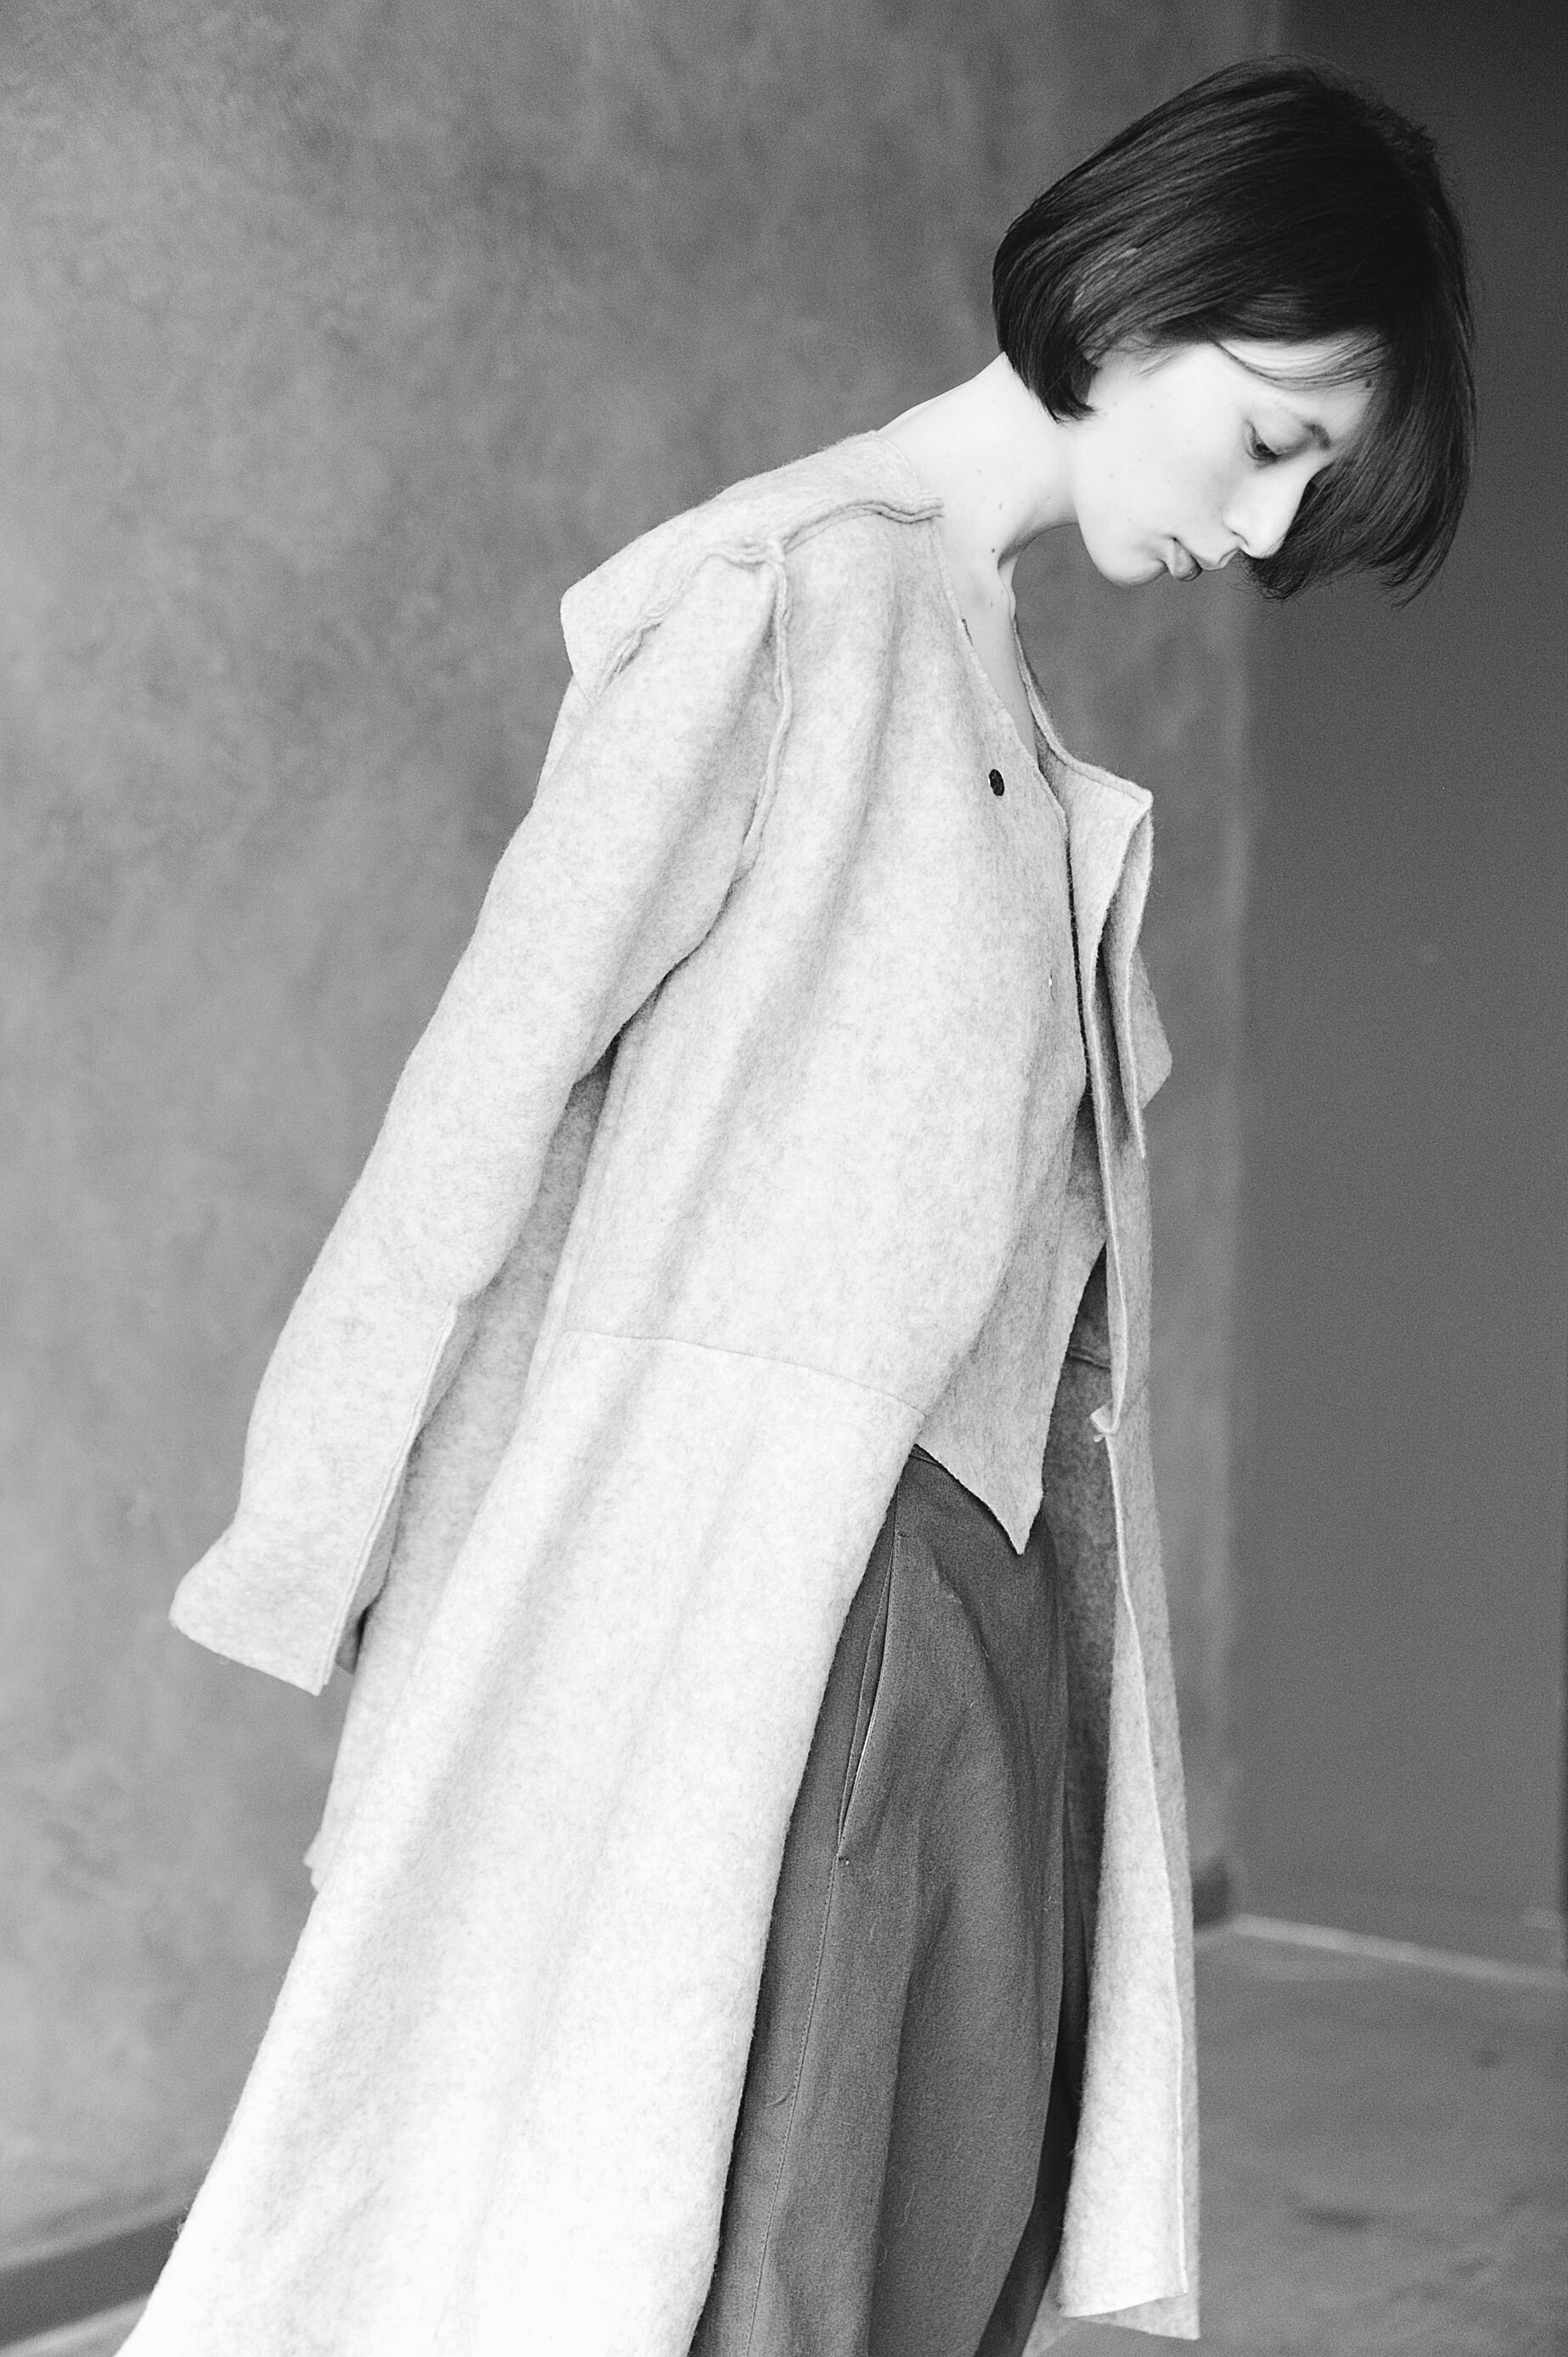
INNOVATION AND ENTREPRENEURSHIP
GROUP 1
Fast fashion

Slide 2

FAST FASHION
Inexpensive clothing produced rapidly by mass-market retailers in response to the latest trends. In previous years, fashion was divided into two seasons: spring and winter, and that was it; some magazines still do so; however, fashion has evolved, and now there is a different trend every week, so people can buy something from the store one week when it is "on trend," but not the next one, and they can easily get rid of it after only using it two or three times. Nowadays instead on having 2 seasons we have 52, each for every week.
THE PROBLEM

Slide 3
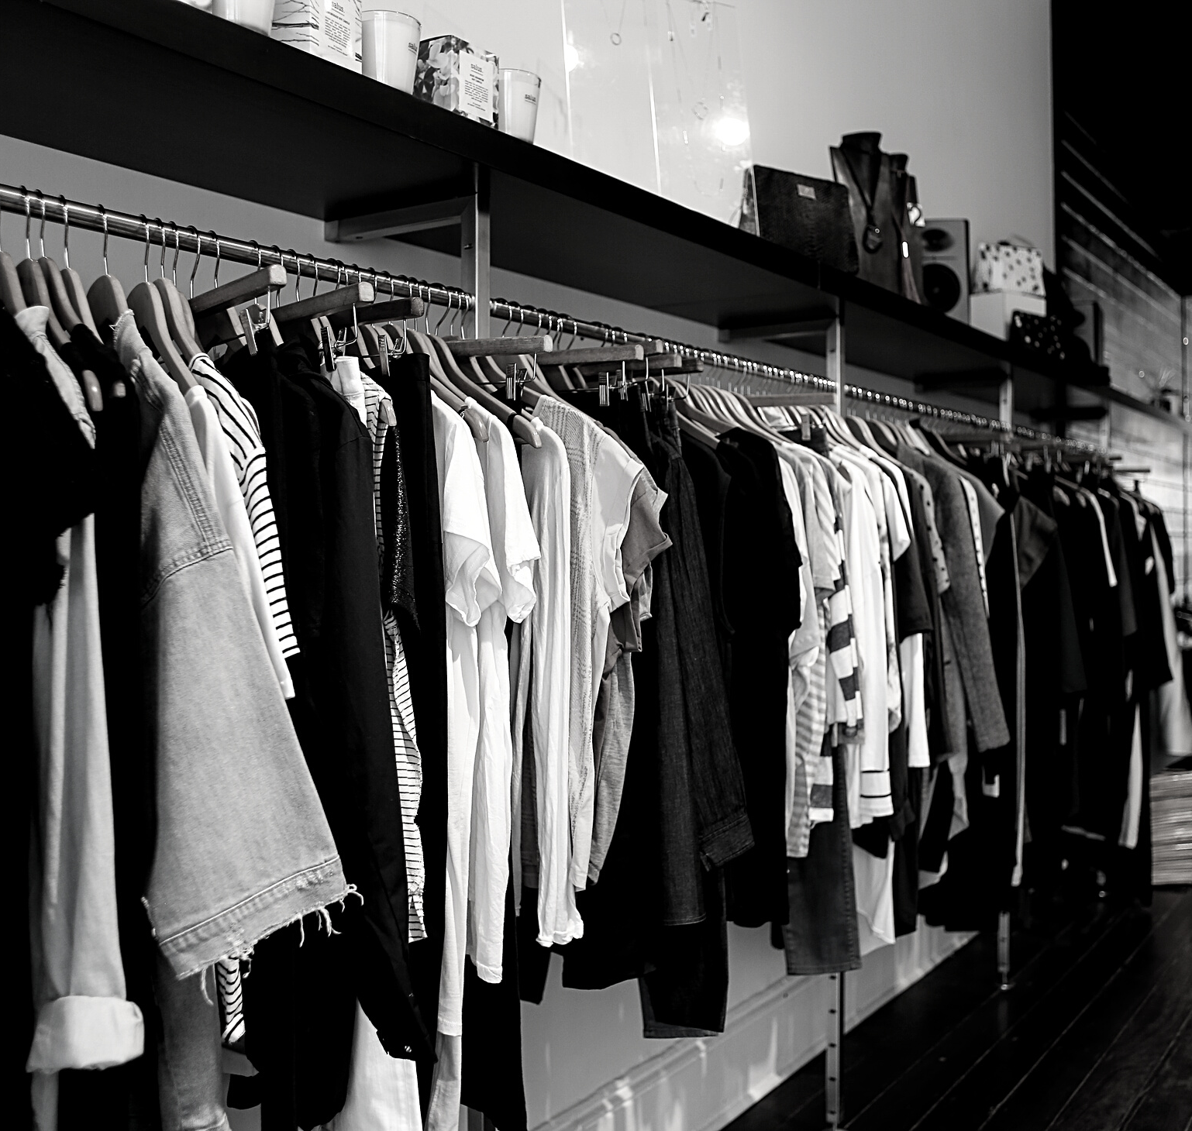
QUICK MATH
AN AVERAGE CONSUMER THROWS AWAY 70 POUNDS(31.75 KILOGRAMS) OF CLOTHING PER YEAR. GLOBALLY WE PRODUCE 13 MILLION TONS OF TEXTILE WASTE EACH YEAR 95% OF WHICH COULD BE REUSED OR RECYLCED
MF | F/W 2020

Slide 4

THE SOLUTION
Designing an app where you can buy second handed clothes, with the caveat that if the quality of the clothes are low, they won't be suitable for sale, having to pass some filters in order to be candidates for a sale. Making brand clothes accessible for everyone and reduce pollution
FLÂNER

Slide 5
MISSION
Our app tackles the negative social and environmental impacts of producing, consuming and wasting clothes by:
• Increasing our use of second-hand clothes.
• Providing people with reuse services to stop wearable clothes being thrown into the waste stream or left unused
Running education programmes and campaigns to raise awareness of the socio-
environmental impacts of clothes and to persuade and inspire people, businesses and policy makers to take action to keep clothes in use for longer.
Funding, supporting and promoting global projects to establish more sustainable
production and safer fairer conditions for people working in the supply chains making our clothes
Putting wearable clothes back into use in our charity shops
MF | F/W 2020

Slide 6
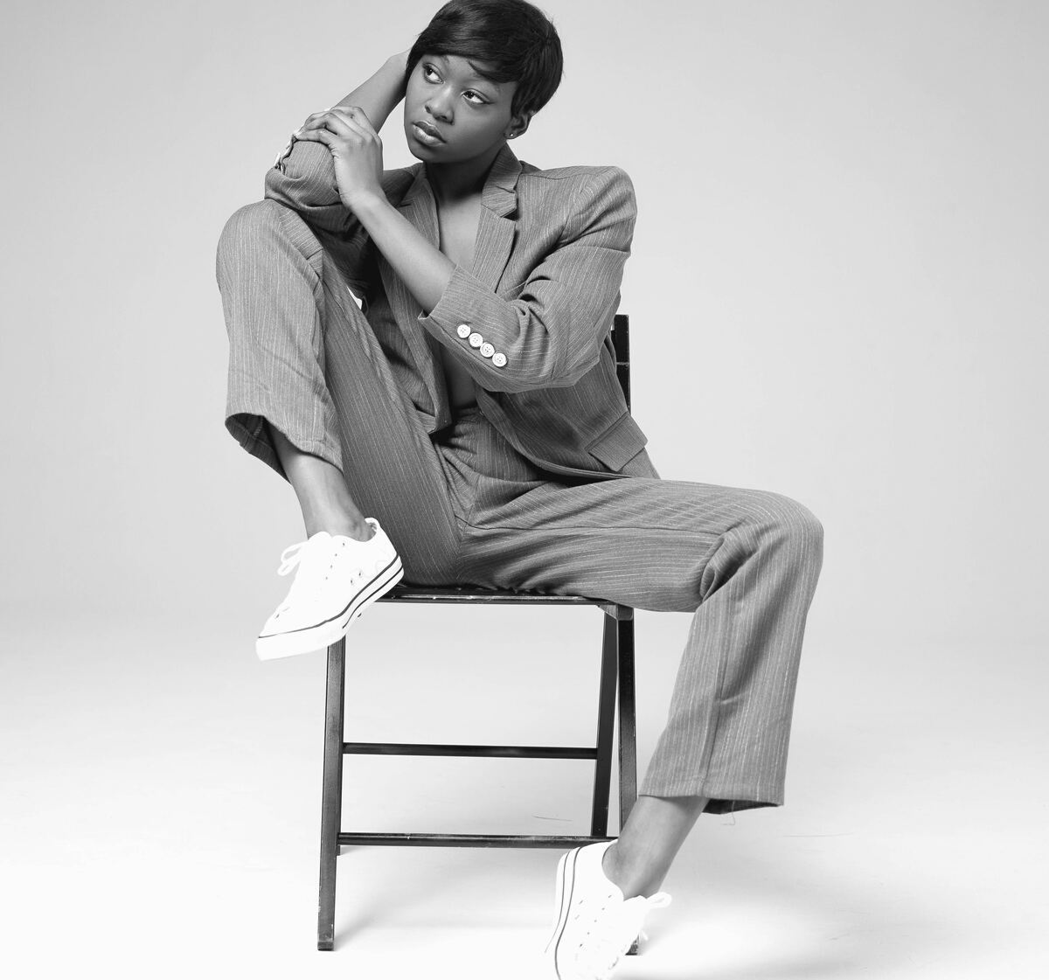
VISION
VALUES
TO CONTRIBUTE TO THE SUSTAINABLE DEVELOPMENT OF SOCIETY AND THAT OF THE ENVIRONMENT WITH WHICH WE INTERACT, GIVE CUSTOMERS WHAT THEY WANT WITH AFFORDABLE PRICE AND GOOD QUALITY
BEAUTY, QUALITY, SIMPLICITY, AND SUSTAINABILITY

Slide 7
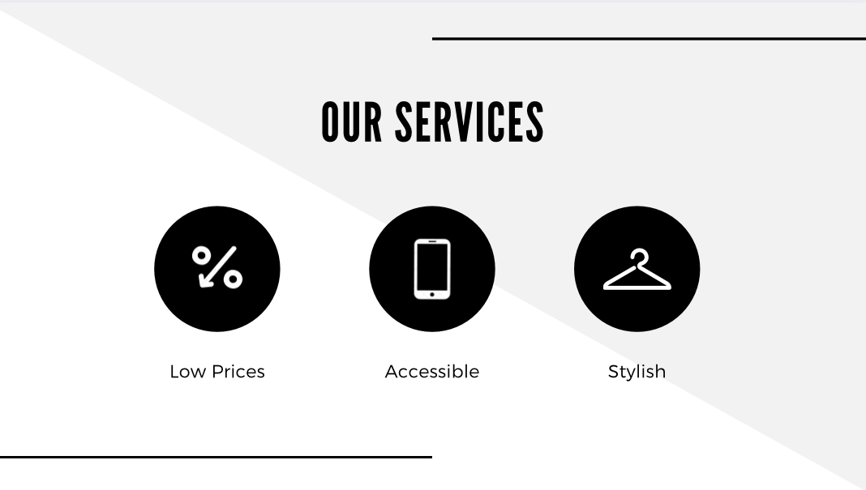

Slide 8
Our target market is young, price-conscious, and highly sensitive to the latest fashion trends. They have an advantage over traditional retailers because they do not define their target by segmenting ages and lifestyles giving them a much broader market.
Studies show that especially young people are proud to buy second-hand. This development is driven by a multitude of factors. Most of them are linked to two key drivers:
• It’s cheaper.
• It’s greener.
AUDIENCE TARGET
.As consumers become more aware of how wasteful fast fashion is, they are increasingly looking for more sustainable alternatives.

Slide 9

What is the business model of fast fashion?
The business model of fast fashion is based on consumers' desire for new clothing to wear. In order to fulfill consumer's demand, fast fashion brands provide affordable prices and a wide range of clothing that reflects the latest trends.
MF | F/W 2020

Slide 10

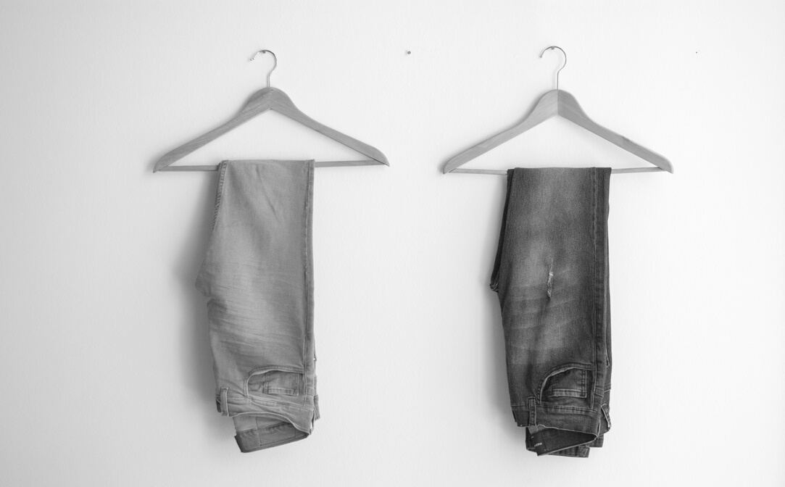
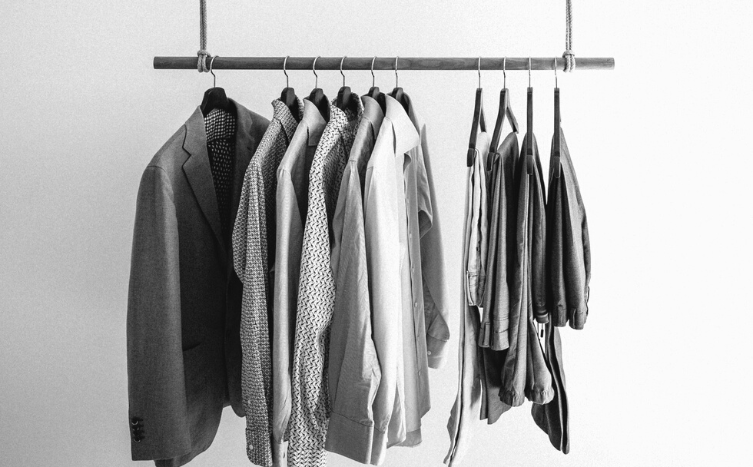
MANAGEMENT
The primary objective of fast fashion is to quickly produce a product in a
cost-efficient manner to respond to fast-changing consumer tastes in as near real time as possible.
BUSINESS STRATEGY
MARKETING
Is the key driver of fast fashion. Marketing creates the desire for consumption
of new designs as close as possible to the point of creation.
PRODUCTION
The consumer in the fast fashion market thrives on constant change and the frequent availability of new products. Fast fashion is considered to be a "supermarket" segment within the larger sense of the fashion market.

Slide 11
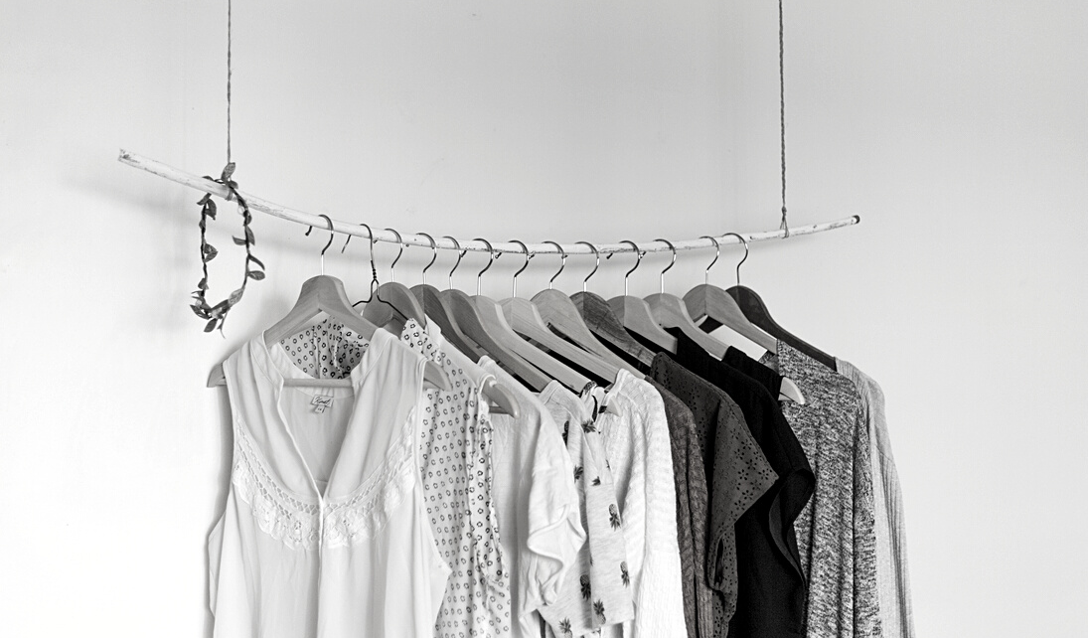
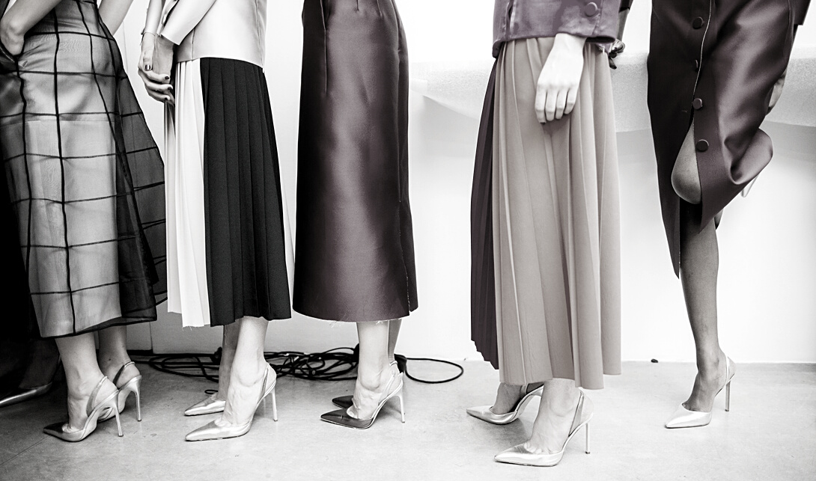
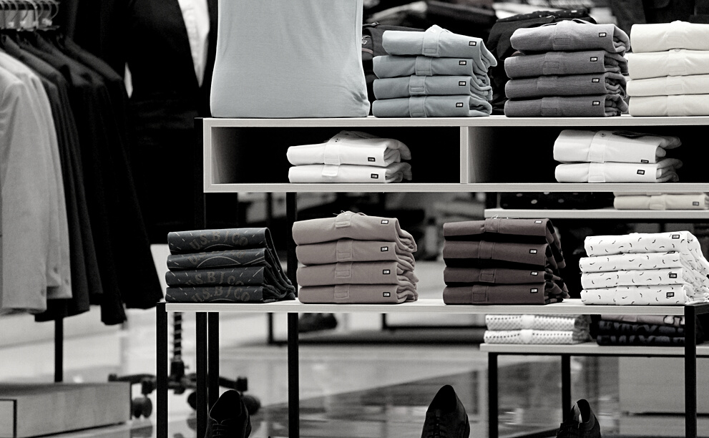
SUPPLY CHAIN
Supply chains are central to the creation of fast fashion. Supply chain
systems are designed to add value and reduce cost in the process of moving goods from design concept to retail stores and finally through to consumption. Efficient supply chains are critical to delivering the retail customer promise of fast fashion.
BUSINESS STRATEGY
VENDOR RELATIONSHIPS
The companies in the fast fashion market also utilize a range of relationships with the suppliers. The product is first classified as "core" or "fashion”.

Slide 12
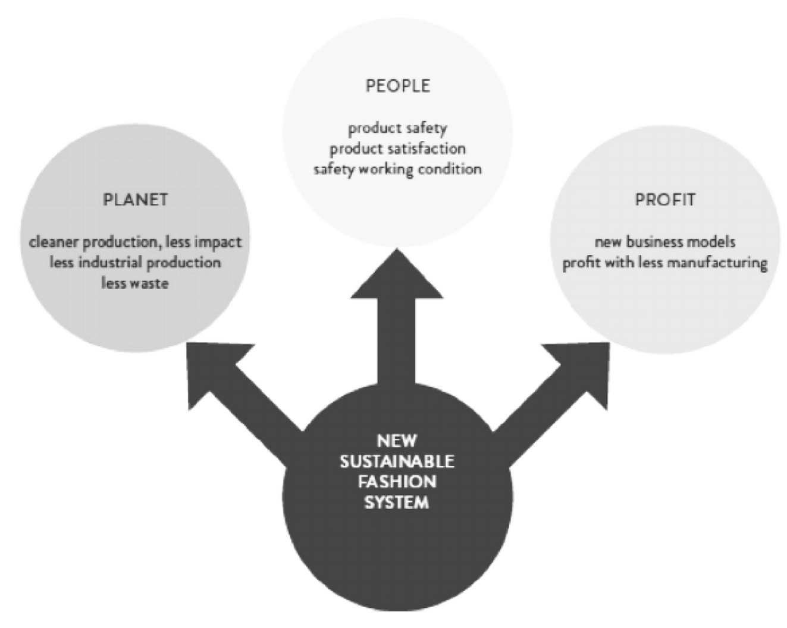
CONCEPT OF OUR PROJECT

Slide 13
STEP 1
Download the application from play store, app store or apple store.
STEP 2
Sign up through mobile number or email.
STEP BY STEP
STEP 3
Set up profile ( name, age, address).
STEP 4
Fill the bank information then start enjoying our new items.

Slide 14
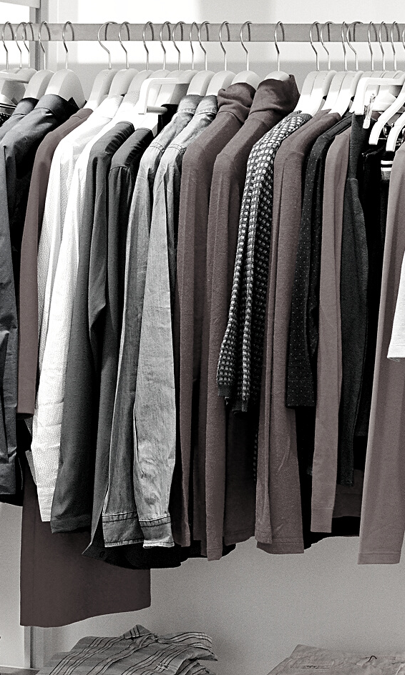
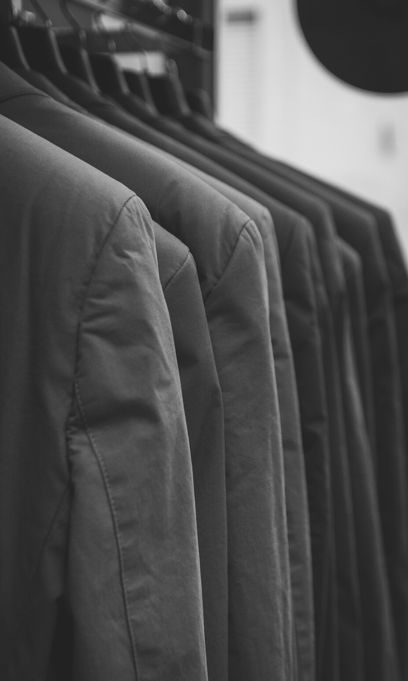
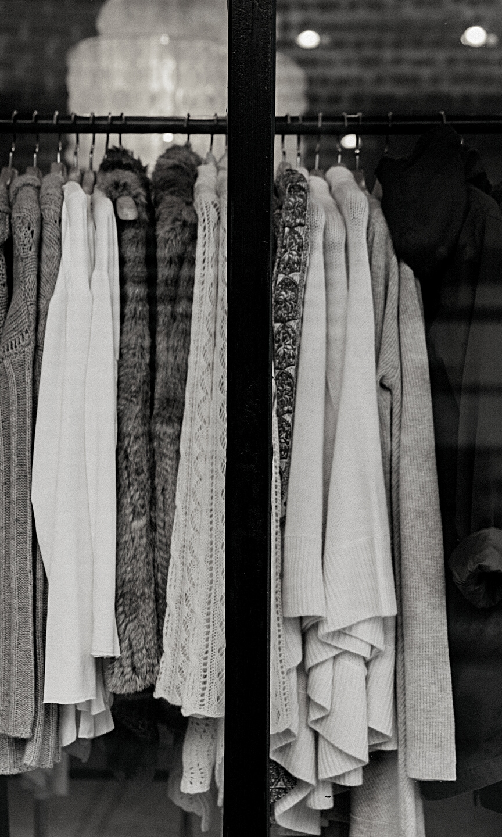
FLÂNER IS UNIQUELY QUALIFIED TO SUCCEED BECAUSE:
·The mobile applications business is a proven business and has succeeded throughout the world.
· Market trends, such as the growth in smartphone users, mobile app downloads, and in sharing economy proves very favorable to Flâner.

Slide 15

FLÂNER ANALYSIS
WE LOVE THE SHARING ECONOMY CONCEPT WHICH IS A TYPE OF MARKET BASED ON A CONCEPT THAT REFERS TO PEER-TO-PEER SHARING OF ACCESS TO PRODUCTS AND SERVICES, WHICH IS FACILITATED THROUGH COMMUNITY-BASED ONLINE SERVICES. THE POSITIVE GOAL IS TO MAXIMIZE THE USE OF EXISTING RESOURCES WHILE AVOIDING OVERPRODUCTION, POLLUTION REDUCTION, AND EQUITABLE DISTRIBUTION.

Slide 16
Consumers aged 18 to 29 accounts for the majority of revenue in the mobile app sector. They have the highest smartphone penetration rate, and are most at ease making online purchases.
Consumers aged 30 to 49 are thought to account for 35% of the market.
MARKET ANALYSIS

Slide 17
Marketing Strategy
MEET CUSTOMER NEEDS
REDUCE CUSTOMER COST
CUSTOMER CONVENIENCE
GOOD COMMUNICATING
preference of consumers according to the feedback information and sales data of customers, and then improve the products
young consumers who are keen on fashion but have limited consumption capacity, and their income is not enough to afford luxury brands.
We'll divide the clothes in categories. ·Different types of clothing will be placed in different areas, so that customers at a glance when buying.
sellers are very friendly and have high professional quality, professional advice on clothing washing and nursing when they are in need.

Slide 18
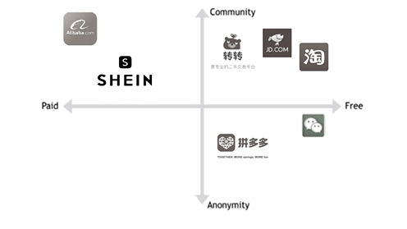
COMPETITIVE ANALYSIS

Slide 19
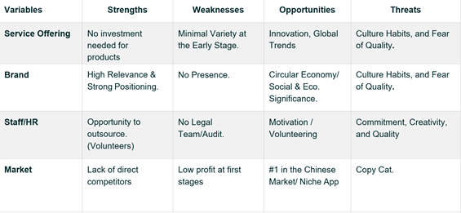
SWOT ANALYSIS

Slide 20

· Good quality product with best price
· Matching choice
· Fast cycle manufacturing process
· Short lead time supply chain models
· Greater flexibility and shorter turnaround time
OPERATIONAL PLAN

Slide 21
· Size guide platform: kind of survey which help customers to choose the right size of products
· Artificial intelligence: using AI to enhance customers' shopping experience, analyze data, boost sales, forecast trends and offer inventory-related guidance.
· Rapid Data Analysis For Quick Adaptation: Rapid data analysis, for quick adaptation, is a way for businesses to quickly adapt their business fragments (such as the supply chain) quickly and efficiently through using large amounts of data to support this adaption by receiving feedback, review
· Mobile Commerce: using our smartphones for shopping online is becoming easier and easier. With digital wallet options like Apple and Android Pay, constantly innovating with new technologies like fingerprint and facial recognition, they're poised to become the preferred payment for retail purchases.
INTELLIGENCE MODEL
Flâner

Slide 22
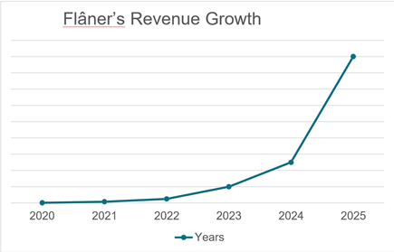
Financial Strategy
By its fifth year of operation, Flâner plans to be well established with the Chinese consumers and Local and National Businesses in China, and ready to enter other major markets. At this time, the executive board will consider profitable exit. Most likely, this acquisition from a larger company – either one that is already in the digital stack place or one that seeks to enter the space with an already established network.
By its 5th year operational year, it is expected that the company will be valued at around $5.1 million. This valuation is based upon a conservative 4x multiple of earnings. Expected valuations for Flâner over the next 5 years are highlighted in the appendix.

Slide 23
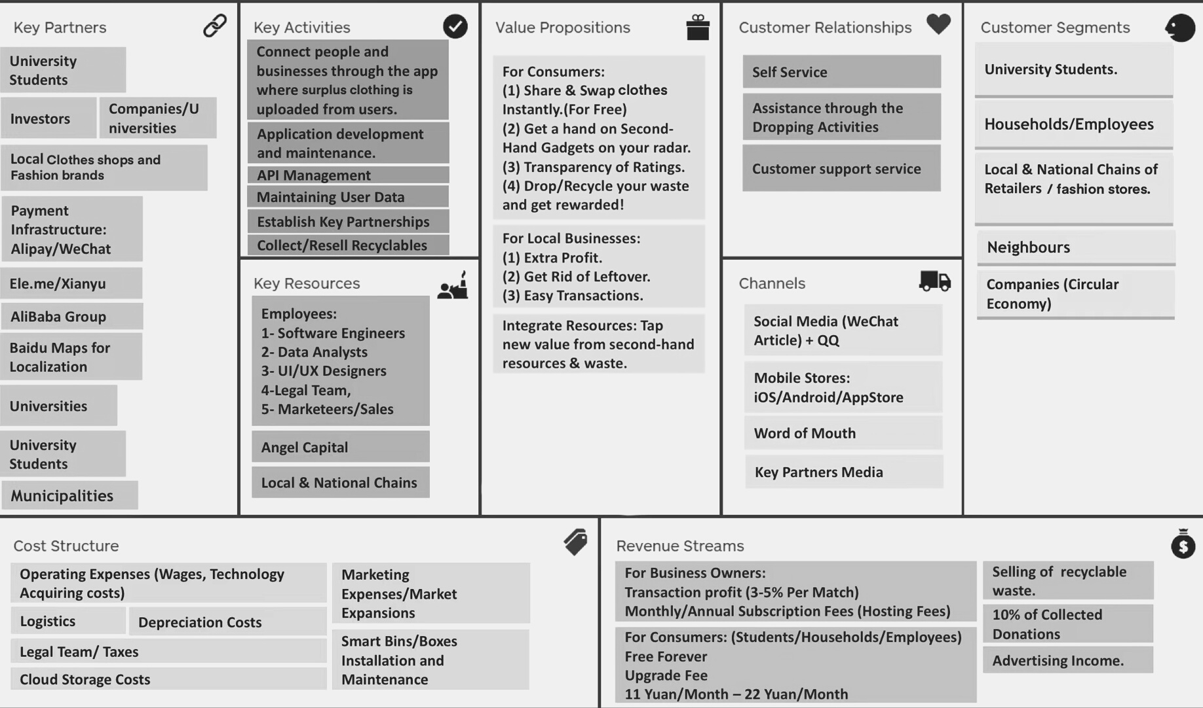
FLÂNER’S BUSINESS MODEL CANVAS

Slide 24
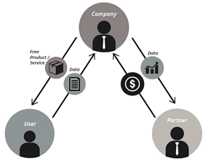
Flâner ’s User Data Monetization Model

Slide 25
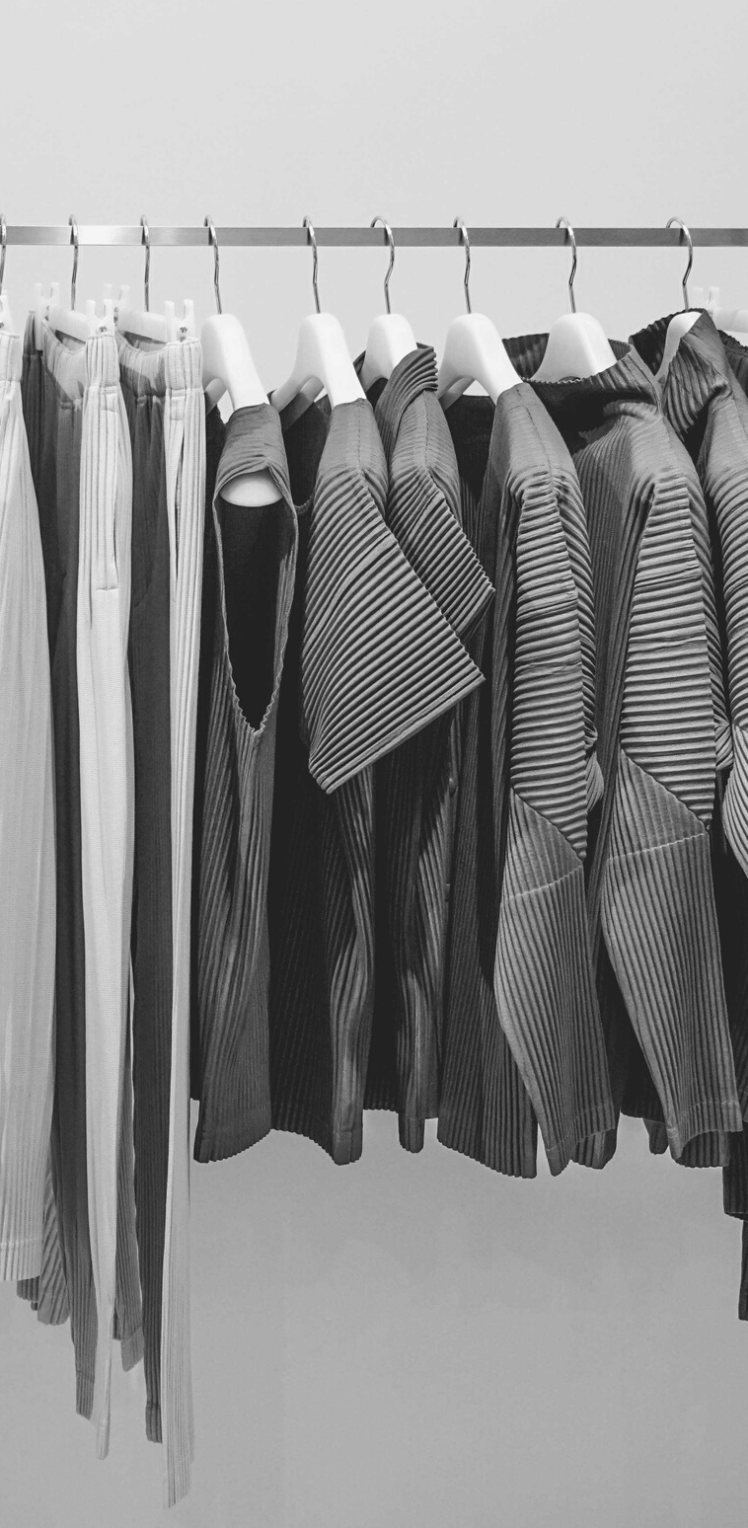
ENVIRONMENTAL IMPACT
ECONOMIC AND SOCIAL IMPACT
- Reducing the User's carboon footprint.
- Sustainable Development..
-Re-utilization of resources.
-Extending product's
life-cycle.
-Controlling consumerism.
-Job creation.
-Reshaping the user's behaviour and mindset.
-Local community enhancement.

Slide 26
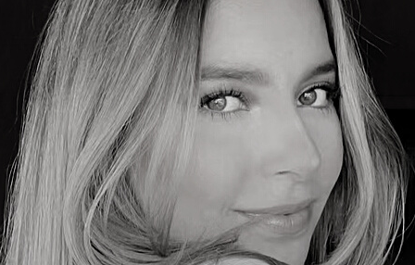
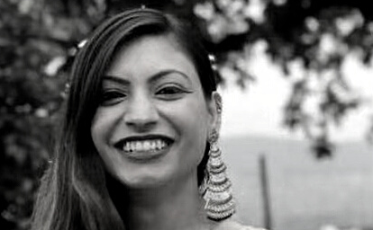
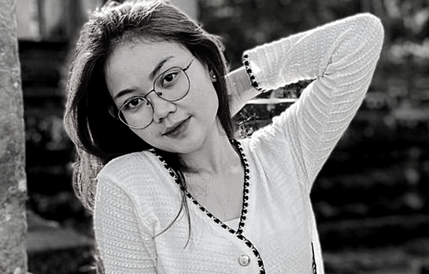
ANDREA SALAS GONZALEZ
Founder and CEO
MAKING
FLÂNER
DIKSHYA KAFLE
Head of technology
CHHORN SREYNEATH
Marketing Co-Director, CFO

